Slide 1
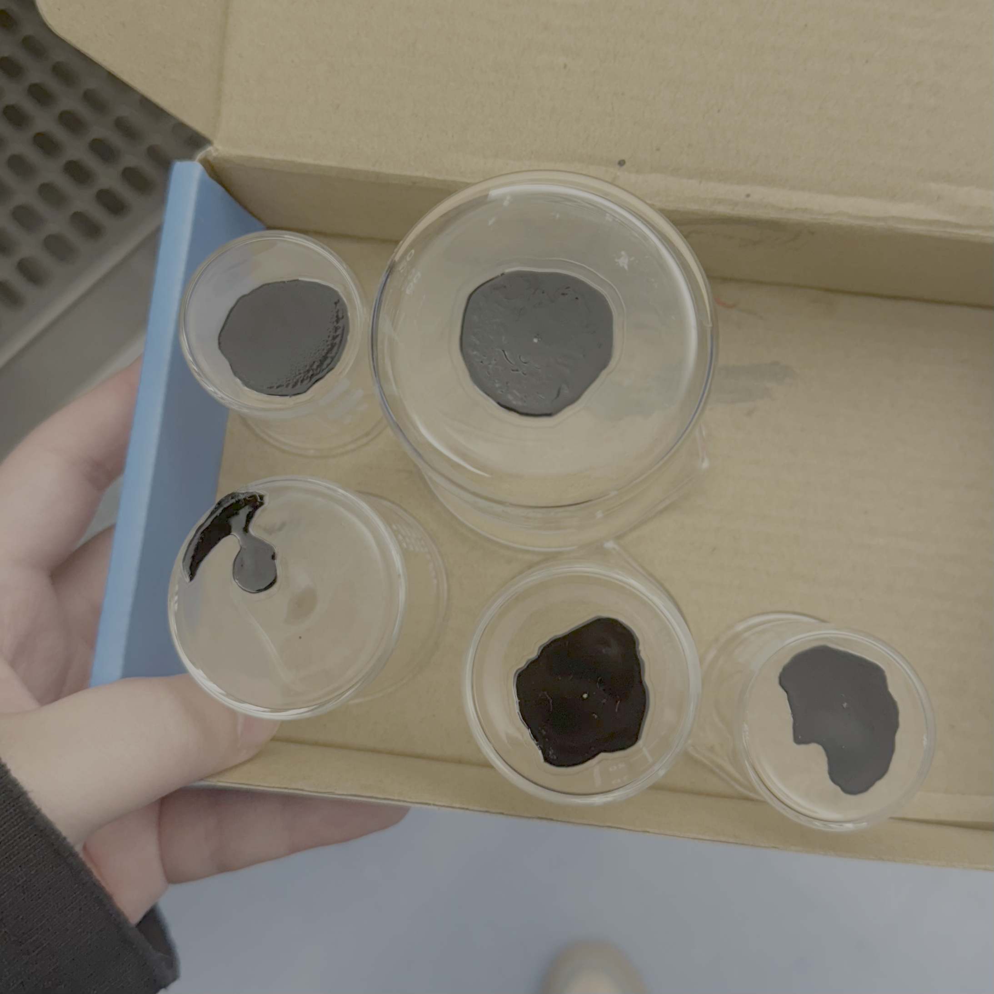
Biomedical Sensors
Siyi Li
College of Engineering and Computing, Miami University
CPB 328: Bioinstrumentation
April 1, 2025

Slide 2
Characteristics of Biomedical Sensors
Sensitivity
Precision
Linearity
Accuracy
Offset

Slide 3
Characteristics of Biomedical Sensors
Sensitivity: The minimum amount of analyte that can be detected by a biosensor defines its limit of detection (LOD) or sensitivity.
Linearity: The attribute that shows the accuracy of the measured response to a straight line, mathematically represented as y=mc, where c is the concentration of the analyte, y is the output signal, and m is the sensitivity of the biosensor.

Slide 4
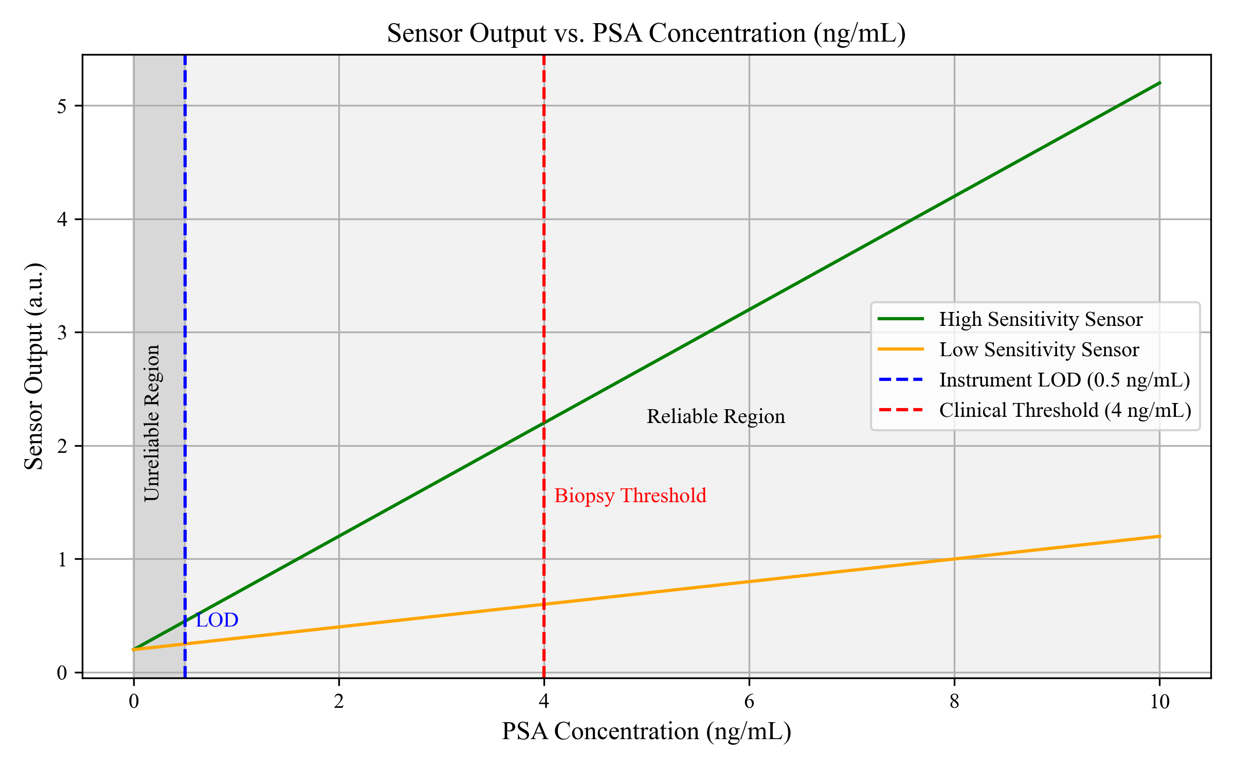
Example: a prostate-specific antigen (PSA) concentration of 4 ng/ml in blood is associated with prostate cancer for which doctors suggest biopsy tests [1].

Slide 5
Characteristics of Biomedical Sensors
Precision: The ability of a sensor to provide consistent and repeatable measurements when measuring the same sample multiple times.
Accuracy: The closeness of the measured value to the true value.
Offset: The output of a sensor when the input is zero.

Slide 6
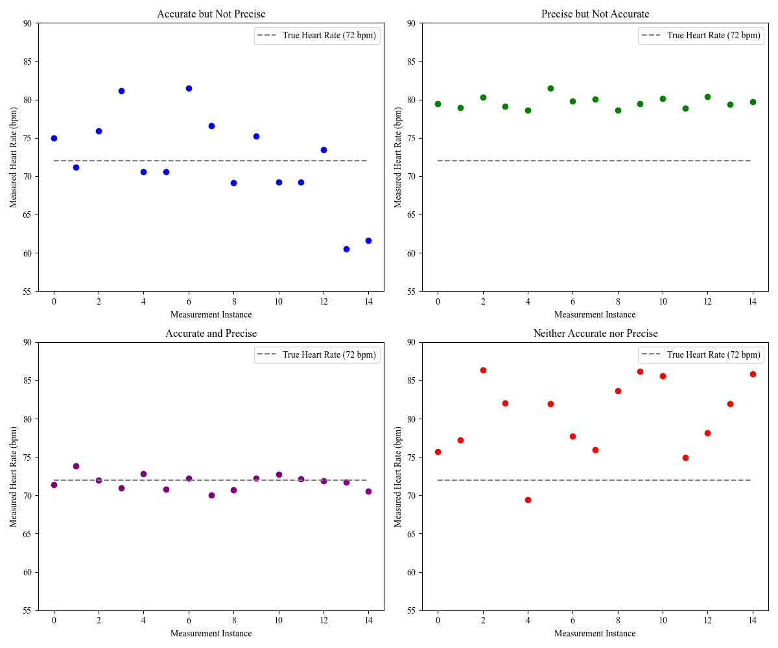
Example: using a wearable sensor to continuously measure a patient’s heart rate, where the true value is known to be 72 bpm.

Slide 7
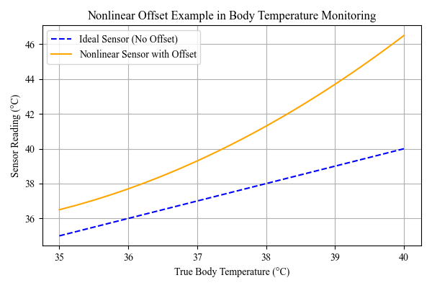
Example: measuring body temperature using a sensor with offset.

Slide 8
Principle and Application of Biomedical Sensors
Capacitive Sensors
Piezoelectric Sensors
Quantum Sensors
Infrared Thermometer Sensors
Optical Sensors
Radiation Thermometry

Slide 9
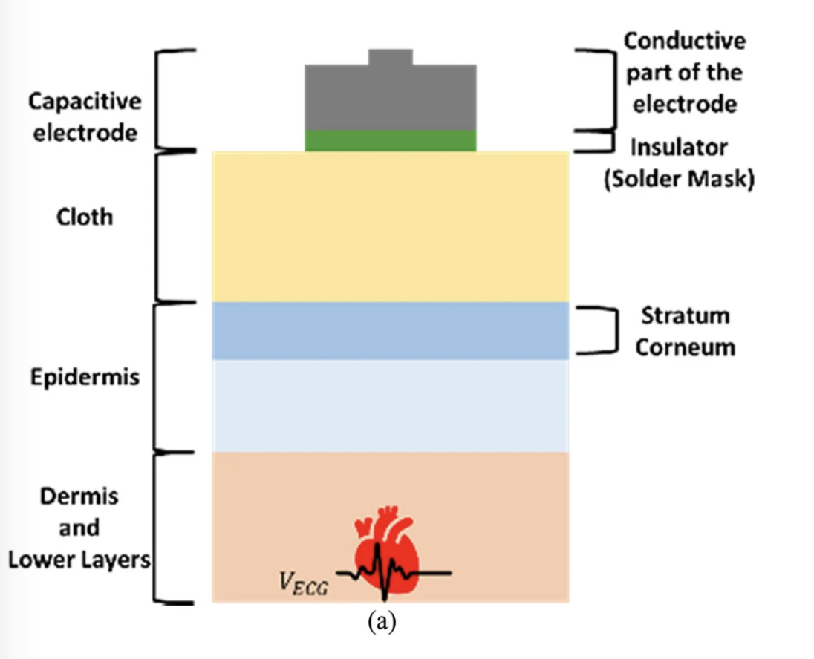
Capacitive Sensors
A capacitive sensor measures changes in capacitance between two conductive plates.
Capacitive sensors offer a non-contact alternative to traditional ECG electrodes, enabling ECG monitoring through clothing and on unprepared skin.
Fig. 1 Adapted from: Motion artifacts in capacitive ECG monitoring systems: a review of existing models and reduction techniques [2].

Slide 10
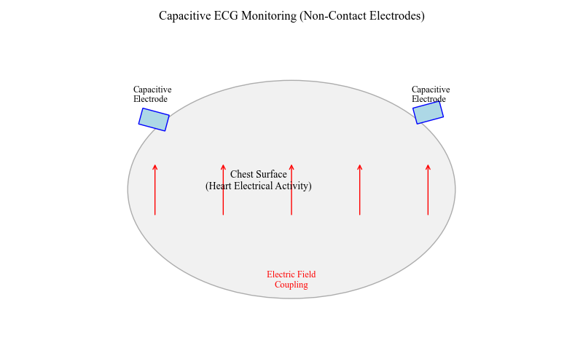
The electrical activity of the heart (ECG signal) is transmitted through the capacitive coupling, allowing for ECG acquisition.
Advantages
Non-invasive
Highly sensitive to even small movement
Lower power consumption
Disadvantages
Can be affected by:
Humidity
Cloth layers

Slide 11
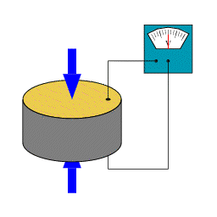
Piezoelectric Sensors
Piezoelectric sensors generate an electric charge when they are mechanically stressed. This effect is reversible.
Mechanical Pressure → Electrical Signal
Piezoelectric sensors are used in various medical devices, including ultrasound imaging devices, drug delivery systems, and diagnostic sensors.
Fig. 2 Piezoelectric disk generating voltage when deformed. Adapted from Tizeff, Wikimedia Commons [3].

Slide 12
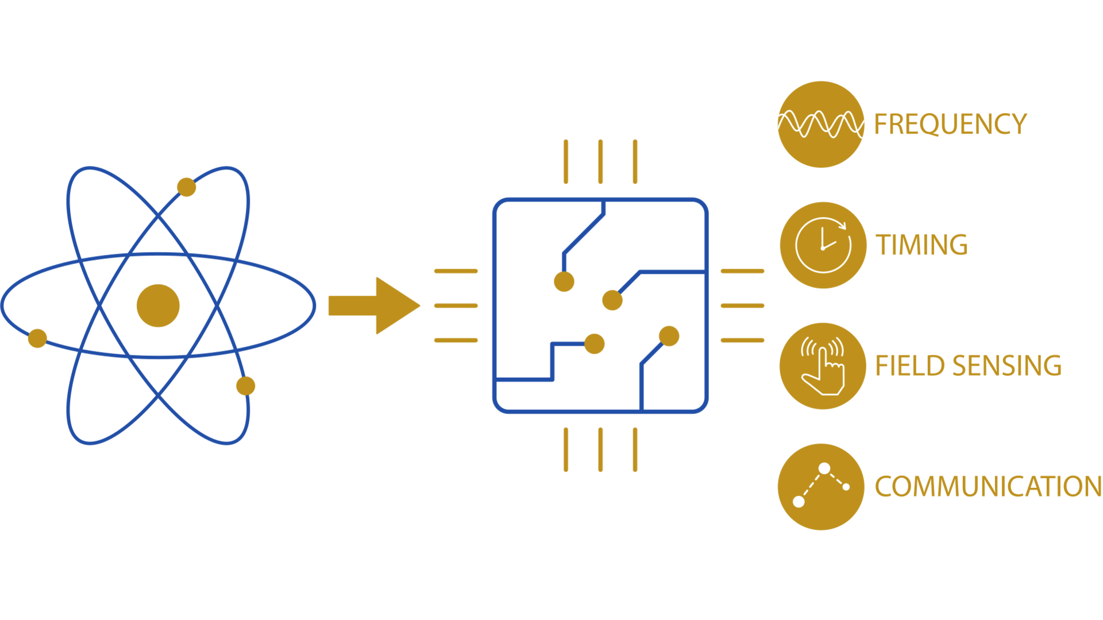
Quantum Sensors
Quantum sensors use principles of quantum mechanics, such as:
Quantum superposition
Quantum entanglement
Spin states of atoms or particles
These allow measurements with extreme precision, especially for:
Magnetic fields
Temperature
Time
Acceleration
Fig. 3 Quantum sensor integration for frequency, timing, field sensing, and communication. Adapted from FBH Berlin [4].

Slide 13
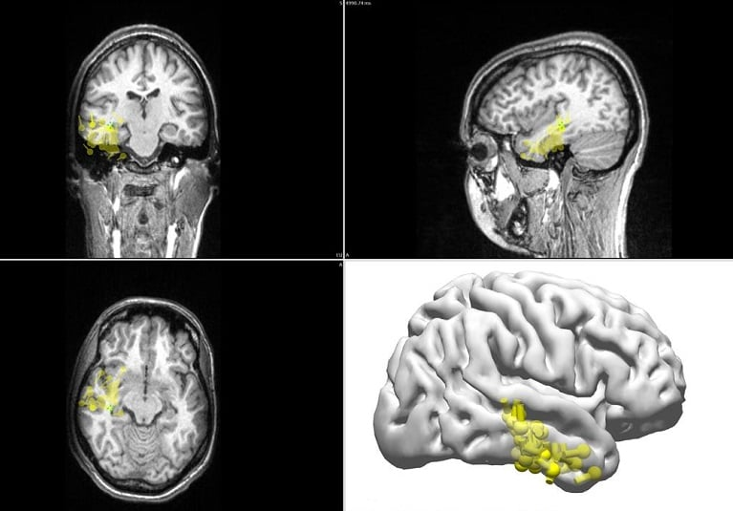
Magnetoencephalography (MEG)
MEG is a technique that maps brain activity by measuring the magnetic fields produced by neurons in the brain. Traditional MEG uses superconducting quantum interference devices (SQUIDs).
Neuronal currents generate extremely tiny magnetic fields. Quantum sensors detect these changes using atomic spin precession, which enables real-time, ultra-sensitive brain mapping.
Fig. 4 Magnetoencephalography (MEG) setup used for epilepsy localization. Adapted from Mayo Clinic [5].

Slide 14
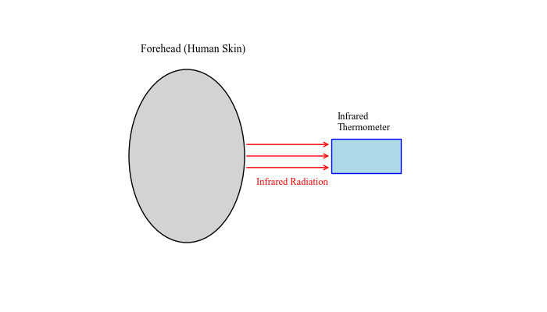
Infrared Thermometer Sensors
All objects emit infrared radiation (IR) depending on their temperature. An infrared thermometer sensor detects this radiation and converts it into a temperature reading without physical contact.
Forehead Thermometer
Advantages
Non-contact
Quick response time
Disadvantages
Not as accurate as internal probes
Can be affected by:
Sweat
Ambient temperature
Distance from skin

Slide 15
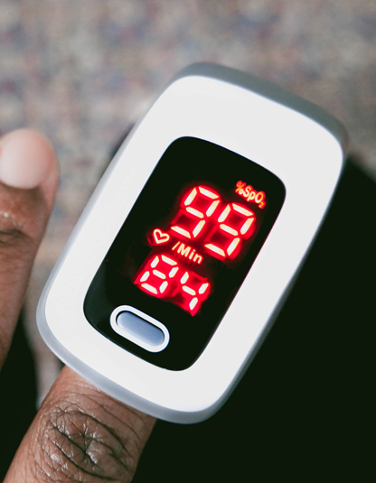
Optical Sensors
Optical sensors detect changes in light
Intensity
Wavelength (color)
Phase
Polarization
The amount or quality of light transmitted, reflected, or absorbed gives info about the material being analyzed.
Fig. 5 A fingertip pulse oximeter using optical sensors to measure oxygen saturation. Image source: FDA.gov [6].

Slide 16
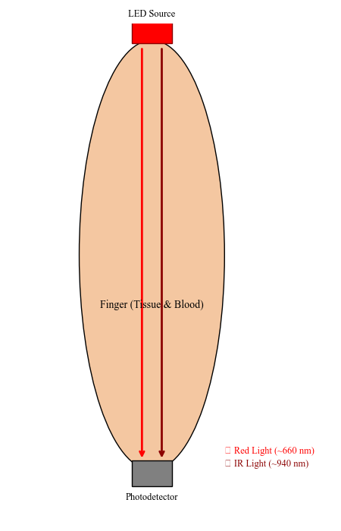
Pulse Oximeter
Measures blood oxygen saturation (SpO₂) and heart rate using light.
How does it work:
Emits two wavelengths of light: red (~660 nm) and infrared (~940 nm)
Light passes through the finger or earlobe
A photodetector on the other side measures the transmitted light
Oxygenated and deoxygenated hemoglobin absorb light differently
Based on absorption, it calculates SpO₂%

Slide 17
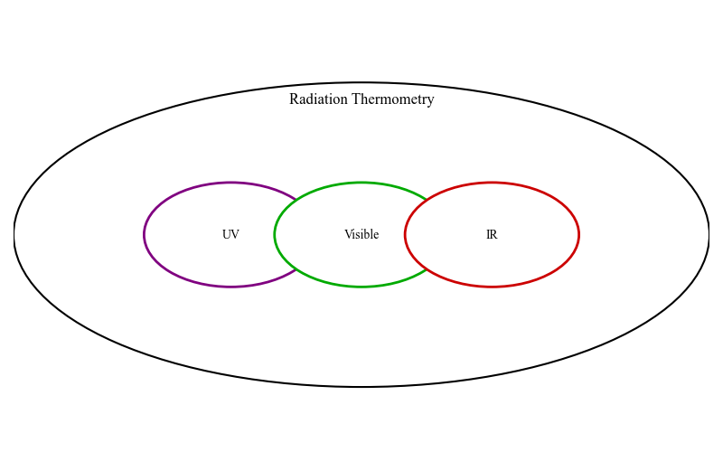
Radiation Thermometry
Radiation thermometry is a technique used to determine the temperature of an object by measuring the electromagnetic radiation it emits, typically in the infrared region.

Slide 18
Reference
[1] N. Bhalla, P. Jolly, N. Formisano, and P. Estrela, “Introduction to biosensors,” Essays in Biochemistry, vol. 60, no. 1, pp. 1–8, June 2016. [Online]. Available: https://www.ncbi.nlm.nih.gov/pmc/articles/PMC4986445.
[2] Y. Xu, A. R. Upadhyay, and B. H. Brown, “Motion artifacts in capacitive ECG monitoring systems: A review of existing models and reduction techniques,” Biomedical Engineering Letters, vol. 9, no. 1, pp. 1–11, 2019. DOI: 10.1007/s13534-019-00099-9.
[3] Tizeff, “A piezoelectric disk generates a voltage when deformed (change in shape is greatly exaggerated),” Wikimedia Commons, Aug. 2013. [Online]. Available: https://commons.wikimedia.org/wiki/File:Piezoelectricity_Disk.gif.
[4] Ferdinand-Braun-Institut, “Integrated Quantum Sensors,” FBH Berlin, [Online]. Available: https://www.fbh-berlin.de/en/research/quantum-technology/integrated-quantum-sensors.
[5] Mayo Clinic Staff, "MEG enhances precision of focal epilepsy localization," Mayo Clinic, Jun. 20, 2024. [Online]. Available: https://www.mayoclinic.org/medical-professionals/neurology-neurosurgery/news/meg-enhances-precision-of-focal-epilepsy-localization/mac-20568548.
[6] U.S. Food and Drug Administration, “Pulse Oximeters,” FDA.gov, Jan. 6, 2025. [Online]. Available: https://www.fda.gov/medical-devices/products-and-medical-procedures/pulse-oximeters.

